Slide 1
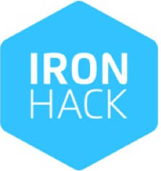
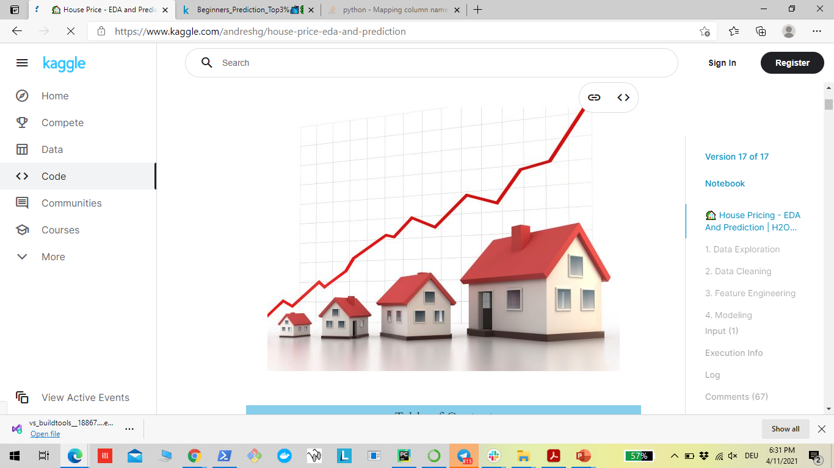
Mini Project: Case study: Fifa_MoneyBall
Mid_Bootcamp_Project: Case Study Regression
Maryam Nazarzadeh
Data Analytics Bootcamp Berlin, March 2022

Slide 2
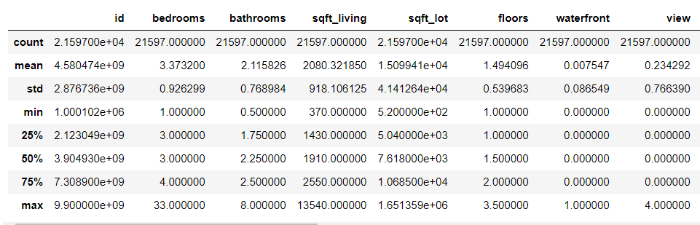
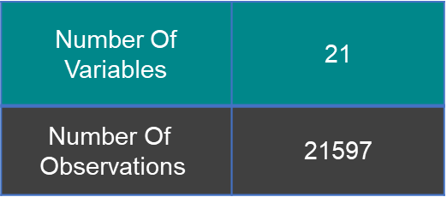
House price dataset from Studen portal
Dataset statistics
Number Of Variables | 21
$$\text{Number} \text{Of} \text{Observations}$$ | 21597
https://github.com/ironhack-edu/data_mid_bootcamp_project_regression

Slide 3
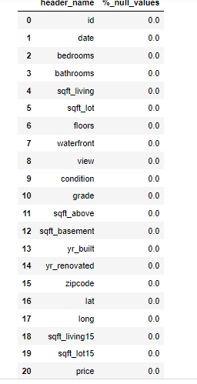
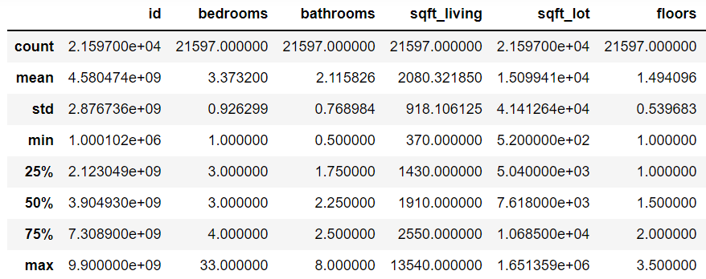
Data Exploration:
Descriptive statistics
Checking missingness
Data visualization
Outlier analysis
Checking and handeling skewness

Slide 4
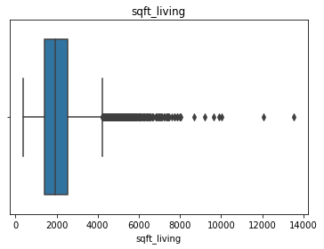
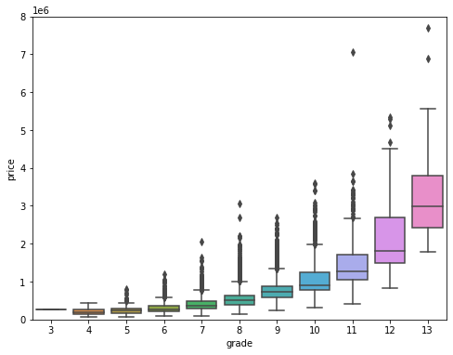
Data Exploration:
Descriptive statistics
Checking missingness
Data visualization
Outlier analysis
Checking and handeling skewness

Slide 5
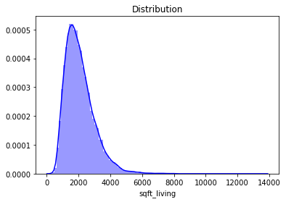
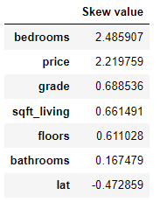
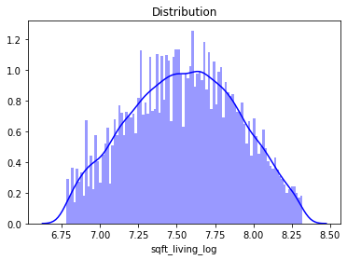
Data Exploration:
Descriptive statistics
Checking missingness
Data visualization
Outlier analysis
Checking and handeling skewness

Slide 6
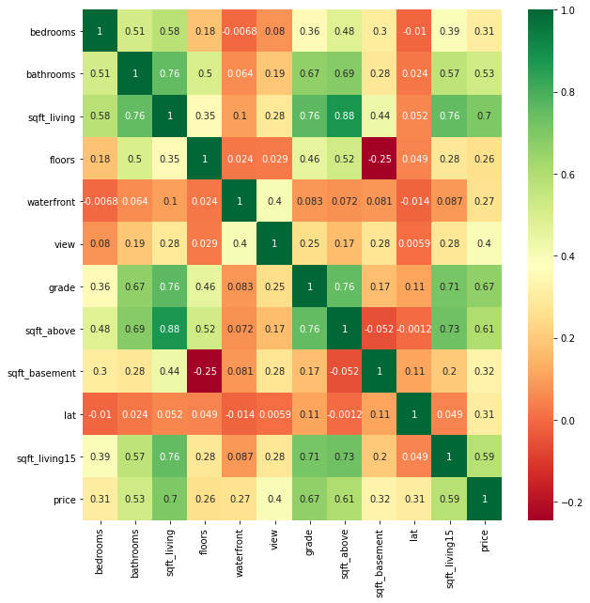
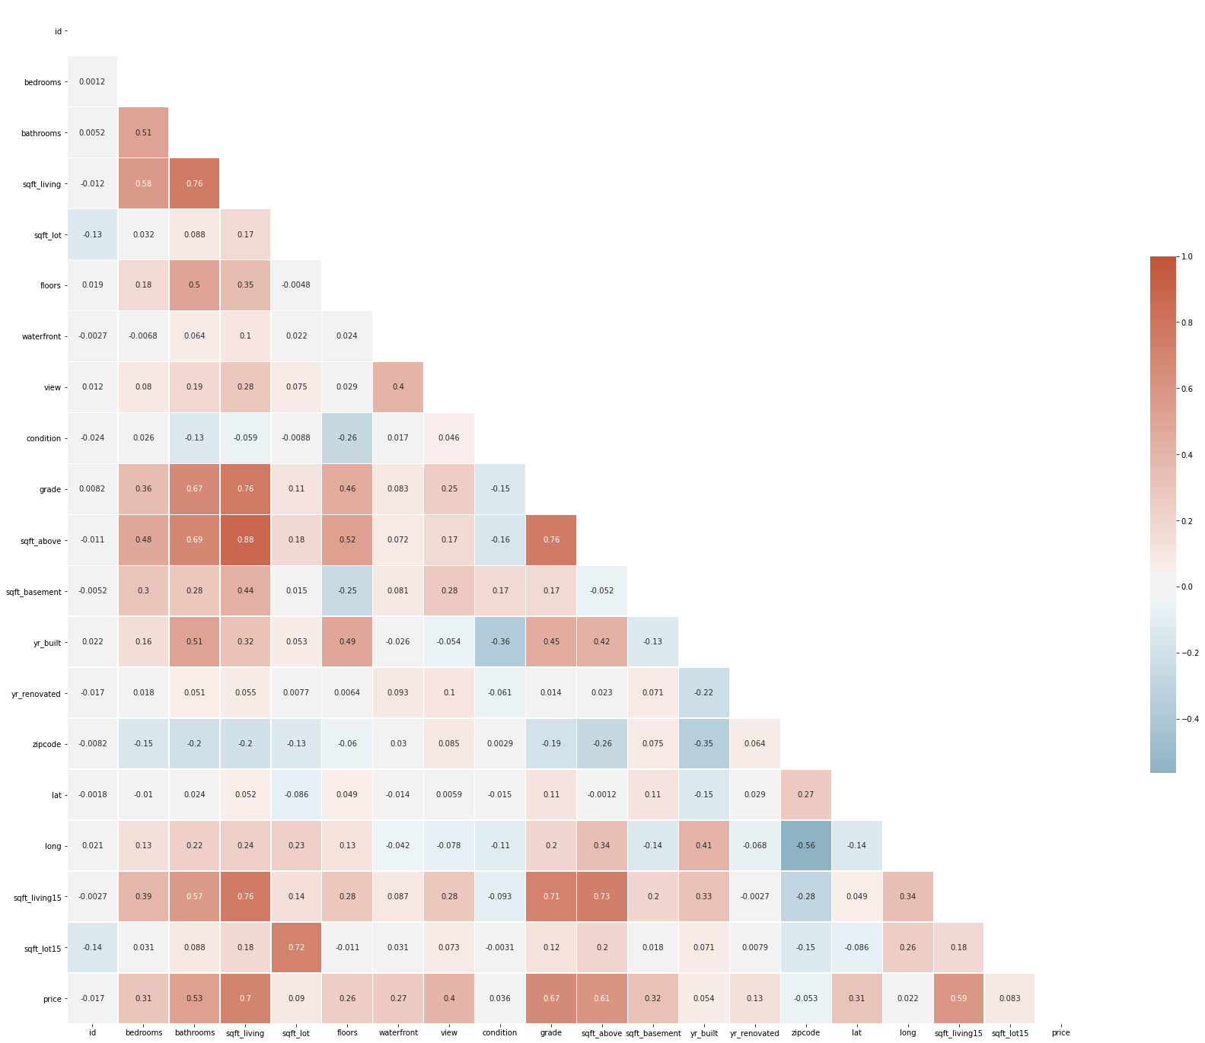
Correlation of the variables:

Slide 7
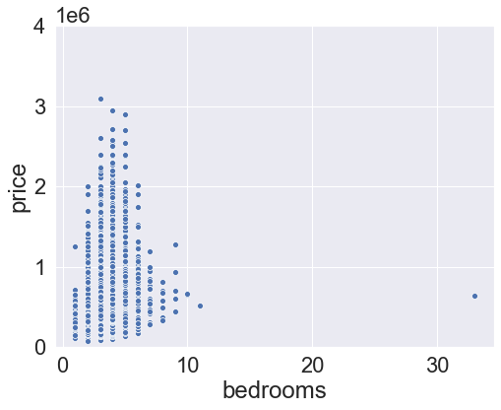
Data visualization:

Slide 8
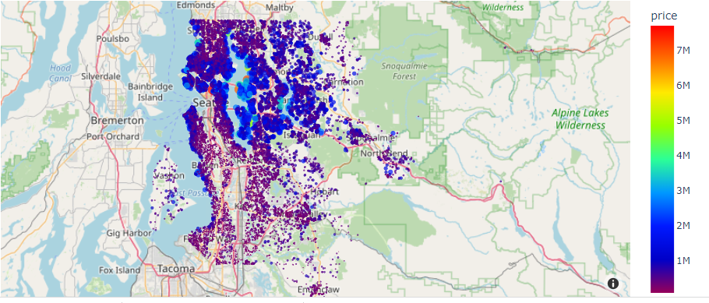
Data visualization:

Slide 9
Modeling:
Taget Sale price prediction?
Applied models:
Linear Regression (variables are linear in the predictor and it could be used after fixing the target and skewness of features)
Ridge Regression (It is most suitable when a data set contains a higher number of predictor variables than the number of observations or when multicollinearity is experienced in a set)
Bayesian Ridge Regression (Usually more accurate then Lreg.)
Selective Vector Regression (High-dimension data/a lot of features)

Slide 10
Modeling:
Taget Sale price prediction?
Applied models:
Decision Tree Regression (Categorical and continuous variables)
Random Forest Regression (Many decision Tree)
Kneighbors Regression (simple and easy)
Gradient Boost Regression (Fast , flexible, no data preprocessing required)
MLP Regression (suitable algorithm where a real-valued quantity is predicted given a set of inputs)

Slide 11
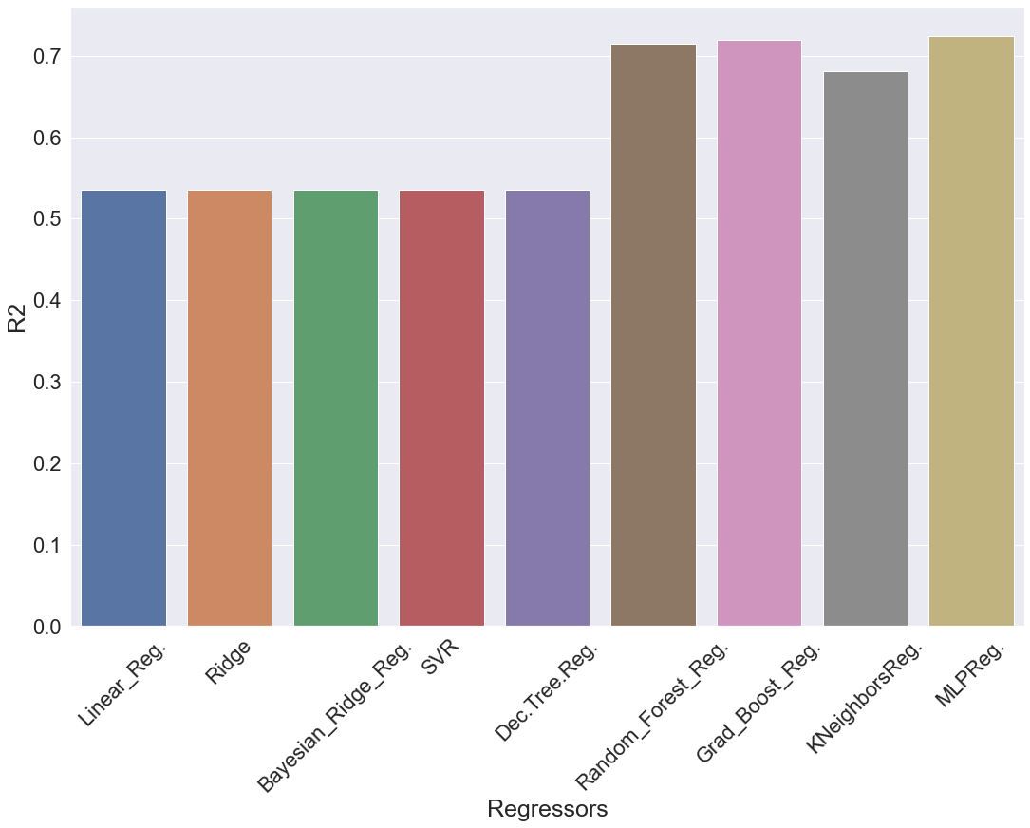
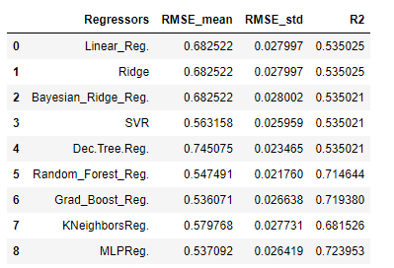
Performance of the applied models:

Slide 12
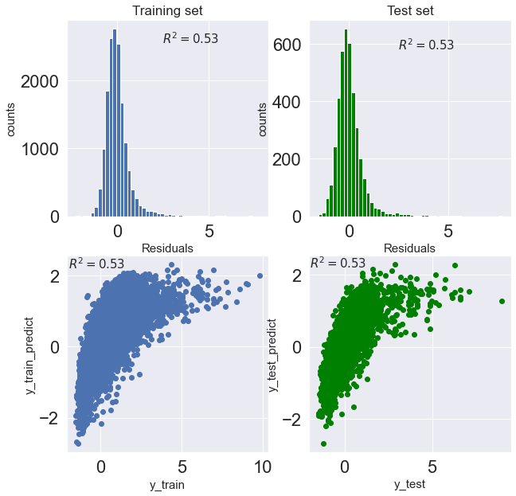
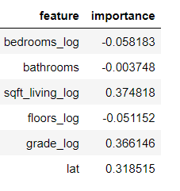
Linear regression:

Slide 13
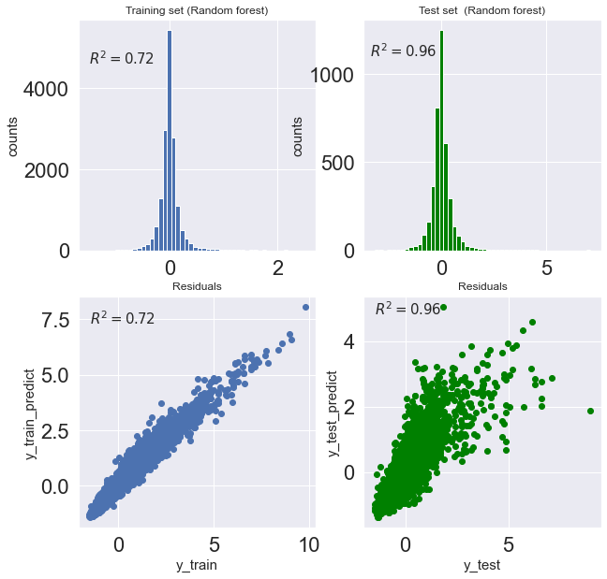
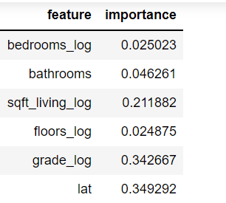
Random Forest Regression:
Overfitting problem!

Slide 14
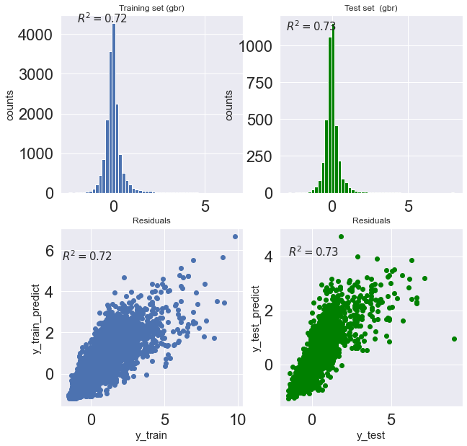
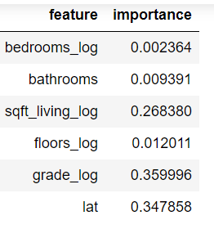
Gradient Boost Regression:

Slide 15
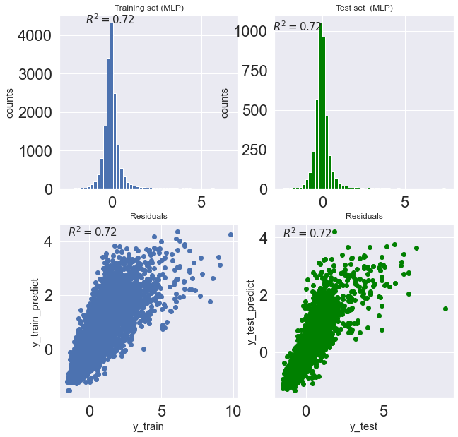
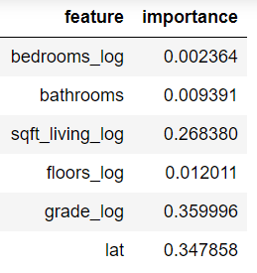
MLP Regression:

Slide 16
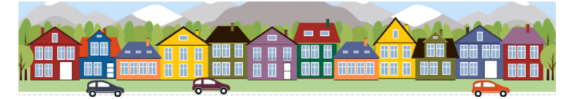
Summary:
Grad_Boost_Reg. and MLP_Reg. Show the best performance among selected models

